Slide 1
CS 425 Software Engineering
Fall 2024
Course Syllabus
Instructors: Sara Davis and Vinh Le
Department of Computer Science and Engineering
August 27, 2024

Slide 2
Syllabus Outline
Capstone Overview
The Instructors & The Students
The Project
CS 425 Overview & Outline
Texts & Other Materials Required
Class Procedures &Structures
Course Requirements (including Grading Scheme & Scale)
University Policies and Instructors’ Policies
Review of Web Campus
Overall Course Objectives
Next Lecture

Slide 3
Capstone Overview: Senior Projects Results in Past Years
Good jobs landed in the US and abroad
Connections with the industry
UNR undergraduate awards
NSF-funded undergraduate awards
Nevada Governor’s Cup prizes
Other business competition awards (e.g., Sontag)
Publications in peer-reviewed journals and conferences
Honors theses
Continuation to graduate studies
Enhanced networking, new friends

Slide 4
Capstone Overview
Present at CoEN Senior Projects Capstone Innovation Day (May 2025)
Continue as a startup / join a company that sponsored the project
CoEN Innovation Day 2024
https://www.unr.edu/engineering/news-and-events/special-events/innovation-day

Slide 5
The Course
CS 425 Software Engineering
Lectures on Tuesdays and Thursdays 10:30 am – 11:45 am, the section will be in-person (WPEB 130).

Slide 6
Instructors
Sara Davis
WPEB 315
sarad@unr.edu
Office Hours: 3pm to 4pm on Tuesdays or by appointment
Vinh Le
WPEB-205
vle@unr.edu
Office Hours: 2pm to 4pm on Thursdays or by Appointment

Slide 7
Teaching Assistants
Levi Scully
WPEB-205
lscully@unr.edu
Office Hours: Tuesdays 2PM – 4PM

Slide 8
The Students
As of August 26, 2024:
152 students registered

Slide 9
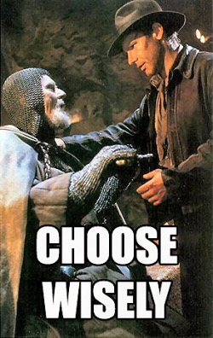
The Project
Think about what you are really interested in
Consider what will help your career/enhance your resume
build a Super Mario clone or
create a cool app that is used by 1000s of people
companies expect you to know the latest tech
Will I learn some new skills?
yes, more systematic software development
also, plenty of cool free tech available – opportunity to learn some new tools not necessarily studied before in CSE
Select your team carefully
find “team players”
combine the right sets skills (minimize overlap)
Teams should be 3 or 4 people
Teams should be determined by Thursday, September 29th

Slide 10
Items to Note and Recommendations about Project Teams
If you only have 3 people on you team, there is the possibility you can be assigned a 4th person in CS426(Spring)
Email the entire teaching team with your teammates listed once you have finalized your team
One of us will respond with your team number
If grouping with acquaintances, a serious conversation will probably be needed. Its work so there can be friction.

Slide 11
CS 425 Overview & Outline
Catalog description: CS 425 SOFTWARE ENGINEERING
Software processes, project management, software requirements, system models, architectural design, detailed design, user interface design, implementation, integration, verification, validation, testing, evolution, rapid development, software tools (major capstone course)
Lecture + Lab: 3 + 0; Credit(s): 3
Pre-requisites: CS326; ENG102; CH201 or CH202 or CH 203; Junior or senior standing
Current enrollment: 152 students

Slide 12
CS 425 Overview & Outline
Course Outline: This course covers the software development process, from requirements elicitation and analysis, through specification and design, to implementation, integration, testing, and maintenance (evolution). A variety of concepts, principles, techniques, and tools are presented, encompassing topics such as software processes, project management, people management, software requirements, system models, architectural and detailed design, user interface design, programming practices, verification and validation, and software evolution. Although the emphasis will be on modern approaches some more traditional software engineering techniques will also be discussed.

Slide 13
CS 425 Overview & Outline
Topics covered:
Software development processes
Agile software development
Software requirements
Requirements elicitation and analysis
Specification and design
Implementation
Integration
Testing
Maintenance (evolution)
Project management
People management
User interface design
System models
Architectural and detailed design
Basics of UML
Verification and validation
Dependable systems
Component-based software engineering
Configuration management
Preparation for CS 426 Senior Projects in Computer Science
Notes:
Course outline: This course covers the software development process, from requirements elicitation and analysis, through specification and design, to implementation, integration, testing, and maintenance (evolution). A variety of concepts, principles, techniques, and tools are presented, encompassing topics such as software processes, project management, people management, software requirements, system models, architectural and detailed design, user interface design, programming practices, verification and validation, and software evolution. Although the emphasis will be on modern approaches some more traditional software engineering techniques will also be discussed.

Slide 14

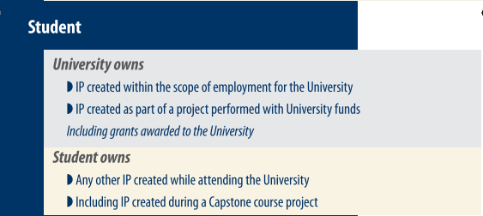
Who Owns My Intellectual Property?

Slide 15
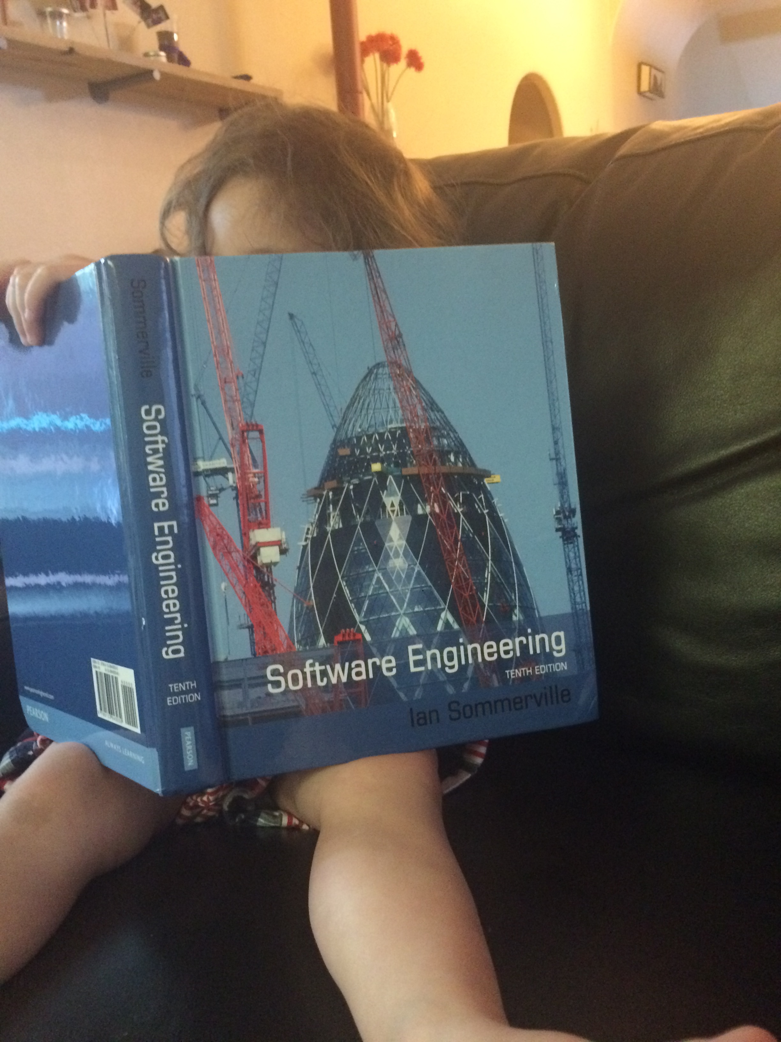
Text & Materials
[SE-10] Ian Sommerville, Software Engineering, 10th Edition, Pearson Higher Ed., 2015, ISBN: 0-13-394303-8 [you can also use the International Edition – English version; but make sure it is 10th Ed]
Lecture notes: include presentations that will be made available by the instructors and notes that you will take during lectures
Additional material as indicated later by the instructors

Slide 16
Class Procedures/Structures
In-person: Physical presence is mandatory for this capstone course. Attendance to lectures will be checked through the use of TopHat, which requires an account.
TopHat is a tool used by the University and is free for our students, you just need to make an account with the same email address as the one you use for WebCampus. Failure to sign up for TopHat correctly will result in a 0 in the in attendance category because WebCampus and TopHat will not sync correctly, so make sure you pay attention when you sign up to TopHat. If you already have an account tied to your WebCampus email because you used TopHat in another class, you have been enrolled and should see the class the next time you log in to TopHat. If you don't already have a TopHat account associated with that email, an invite was sent to the email you signed up for WebCampus with. Please don't do a class search as it will make it more likely for you to use the wrong email.

Slide 17
Class Procedures/Structures
Capstone course with both individual and teamwork requirements -- specifically, individual assignments, class participation, a midterm exam and a final exam; also, a team project involving 3 or 4 students in each team, and developed in four software engineering phases: concept, specification, design, and prototype. The course also includes team meetings with the instructors for project approval and project demos as well as a short in-class project presentation by each team.
UNR College of Engineering’s Guidelines for Sponsored Senior Design Engineering Capstone Projects are available at the following link (please note that a Capstone Guidelines document must be signed by students, instructors, and sponsors): https://www.unr.edu/engineering/news-and-events/special-events/innovation-day/guidelinesLinks to an external site.

Slide 18
Student Learning Outcomes [SLOs] [in bold, outcomes of CS 425: 4, 5, 6]
Identify, formulate, analyze, and solve complex computing or engineering problems by applying principles of computing, engineering, science, and mathematics.
Design, implement, and evaluate a computing or engineering solution to meet a given set of requirements, with consideration of public health, safety, and welfare, as well as global, cultural, social, environmental, and economic factors.
Communicate effectively in a variety of professional contexts, with a range of audiences.
Recognize professional responsibilities and make informed judgments in engineering and computing practice based on legal and ethical principles, considering the impact of solutions in global, economic, environmental, and societal contexts.

Slide 19
Student Learning Outcomes [cont’d] [in bold, outcomes of CS 425: 4, 5, 6]
5. Function effectively as a member or leader of a team engaged in activities appropriate to the program's discipline, creating a collaborative and inclusive environment, establishing goals, planning tasks, and meeting objectives.
6. Apply computer science theory and software development fundamentals to produce computing-based solutions.
7. Develop and conduct appropriate experimentation, analyze and interpret data, and use engineering judgment to draw conclusions.
8. Acquire and apply new knowledge as needed, using appropriate learning strategies.

Slide 20
CSE Program Educational Objectives
Within 3 to 5 years of graduation our graduates will:
Be employed as computer science or computer engineering professionals beyond entry level positions or be making satisfactory progress in graduate programs.
Have peer-recognized expertise together with the ability to articulate that expertise as computer science or computer engineering professionals.
Demonstrate strong analytic, design, and implementation skills required to formulate and solve computer science or computer engineering problems in a professional or research environment.
Demonstrate that they can function, communicate, collaborate and continue to learn effectively as ethically and socially responsible computer science or computer engineering professionals.

Slide 21
Course Requirements
Exams
This course has a midterm test (on TUESDAY October 22, 2024, regular class time) and a final exam (on TUESDAY December 17, 2024 from 10:15 to 12:15 am). More information will be available on Web Campus.

Slide 22
Grading Scheme (tentative)
Individual assignments A1, A2 12%
Team Assignments P1,P2,P3,P4, Pres 48%
Midterm MT 14%
Final Exam (comprehensive) EXAM 22%
Class & Team participation CP 4%
In order to pass the course you need to obtain the following:
At least 50% overall
At least 50% in tests (midterm test + final exam)
At least 50% in applications (project parts P1, P2 and P3 + assignments A1 and A2 + class participation CP)
A least 50% in project prototype and demo (P4).
You need a C or better in CS 425 to take CS 426 Senior Projects
Technically, there are no make-ups for homework or tests in this course; however, in well-justified cases extensions could be given.

Slide 23
Grading Scale
A 90-100
A- 87-89
B+ 84-86
B 80-83
B- 77-79
C+ 74-76
To obtain grade A you need to obtain at least 90% overall and at least 90% in class participation
Poor class participation can significantly affect your overall grade
C 70-73
C- 67-69
D+ 64-66
D 60-63
D- 50-59
F < 50

Slide 24
Late Submission Policy
Late submissions:
Late submissions of homework will be penalized with a deduction of 10% of the grade per late day, to a maximum of two late days for each submission. No material will be accepted after two days past the deadline.
For example, an assignment that is worth 90/100 points will receive 90*0.9 = 81/100 points if it is one day late. The same assignment will receive 90*0.8 = 72/100 points if it is two late days and it will not be accepted if it is more than two days late. Late days are not divisible in subunits.

Slide 25
University Policies

Slide 26
Statements on COVID-19 Policies
Face Coverings
Pursuant to Nevada law, NSHE employees, students and members of the public are not required to wear face coverings while inside NSHE buildings irrespective of vaccination status. However, students may elect wear face coverings if they choose.
Disinfecting Your Learning Space
Disinfecting supplies are provided for your convenience to disinfect your learning space. You may also use your own disinfecting supplies.

Slide 27
Statements on COVID-19 Policies
Testing Positive for COVID-19 or Exhibiting COVID-19 Symptoms
Students testing positive for COVID 19 or exhibiting COVID 19 symptoms will not be allowed to attend in-person instructional activities and must leave the venue immediately. Students should contact the Student Health Center or their health care provider to receive care and information pertaining to the latest COVID 19 quarantine and self-isolation protocols. If you are required to quarantine or self-isolate, you must contact your instructor immediately to make instructional and learning arrangements.

Slide 28
Statements on COVID-19 Policies
Accommodations for COVID 19 Quarantined Students
For students who are required to quarantine or self-isolate due to testing positive for COVID or exhibiting COVID 19 symptoms, instructors must provide opportunities to make-up missed course work, including assignments, quizzes or exams. In courses with mandatory attendance policies, instructors shall not penalize students for missing classes while quarantined.

Slide 29
Statement on Academic Dishonesty
The University Academic Standards Policy defines academic dishonesty, and mandates specific sanctions for violations. See the University Academic Standards policy: UAM 6,502.

Slide 30
Statement on Student Compliance with University Policies
In accordance with section 6,502 of the University Administrative Manual, a student may receive academic and disciplinary sanctions for failure to comply with policy, including this syllabus, for failure to comply with the directions of a University Official, for disruptive behavior in the classroom, or any other prohibited action. “Disruptive behavior" is defined in part as behavior, including but not limited to failure to follow course, laboratory or safety rules, or endangering the health of others. A student may be dropped from class at any time for misconduct or disruptive behavior in the classroom upon recommendation of the instructor and with approval of the college dean. A student may also receive disciplinary sanctions through the Office of Student Conduct for misconduct or disruptive behavior, including endangering the health of others, in the classroom. The student shall not receive a refund for course fees or tuition.

Slide 31
Statement on Disability Services
Any student with a disability needing academic adjustments or accommodations is requested to speak with us (the instructors) or the Disability Resource Center (Pennington Achievement Center Suite 230) as soon as possible to arrange for appropriate accommodations.
This course may leverage 3rd party web/multimedia content, if you experience any issues accessing this content, please notify your instructor.

Slide 32
Statement on Audio and Video Recording
Student-created Recordings
Surreptitious or covert video-taping of class or unauthorized audio recording of class is prohibited by law and by Board of Regents policy. This class may be videotaped, or audio recorded only with the written permission of the instructor. In order to accommodate students with disabilities, some students may have been given permission to record class lectures and discussions. Therefore, students should understand that their comments during class may be recorded.

Slide 33
Statement on Audio and Video Recording
Instructor-created Recordings
Class sessions may be audio-visually recorded for students in the class to review and for enrolled students who are unable to attend live to view. Students who participate with their camera on or who use a profile image are consenting to have their video or image recorded. If you do not consent to have your profile or video image recorded, keep your camera off and do not use a profile image. Students who un-mute during class and participate orally are consenting to have their voices recorded. If you do not consent to have your voice recorded during class, keep your mute button activated and only communicate by using the "chat" feature, which allows you to type questions and comments live.

Slide 34
Statement on Maintaining a Safe Learning and Work Environment
The University of Nevada, Reno is committed to providing a safe learning and work environment for all. If you believe you have experienced discrimination, sexual harassment, sexual assault, domestic/dating violence, or stalking, whether on or off campus, or need information related to immigration concerns, please contact the University's Equal Opportunity & Title IX office at 775-784-1547. Resources and interim measures are available to assist you. For more information, please visit the Equal Opportunity and Title IX page.

Slide 35
Instructors’ Policies

Slide 36
Instructor Policies
Illness or Other Personal Issue
If you are sick or have a health-related reason for not attending class, let the instructors know as soon as possible about this situation. Same, for a major family or personal issue.
Course/Policy Modification
The instructors reserve the right to add to, and/or modify any of the above policies as needed to maintain an appropriate and effective educational atmosphere in the classroom and the laboratories. In the case that this occurs, all students will be notified in advance of implementation of the new and/or modified policy.

Slide 37
Overall Course Objectives
Coverage of the phases of the software process through study of related concepts, principles and techniques as well as practical software development work using a systematic engineering approach
Main directions:
Study of software engineering concepts, principles, and techniques
Extensive coverage of the phases and activities of the software process
Study of several advanced software engineering topics such as dependable systems and component-based software engineering
Practical software development work within the framework of integrated development environments

Slide 38
Brief Course Schedule
September 2024
Introduction to Software Engineering
Company/faculty pitches
Team formation and project selection
October 2024
Team meetings with instructors; project proposals approved
Midterm, TUE October 22, 2024 from 10:30 am (regular class time)
Software specification
November 2024
Software design
Team presentations
December 2024
Software implementation
Project prototypes/demos
Final exam, TUE December 17, 2024 from 10:15 am
Detailed tentative schedule available on Web Campus

Slide 39
Review of Web Campus & Tentative Detailed Schedule

Slide 40
Information on 426
Software Engineering/Senior Projects is a year long class spanning fall and Spring semesters
Senior Projects will focus more on Implementation while Software Engineering will focus on design.
Don’t push this class off for weeks or months at a time, it WILL 100% hurt you.
Keep a constant steady pace and you will be just fine.
If you fail to achieve a decent design this semester, you will essentially be doing the burden of 425 into 426
The teaching team will remain similar between 425 and 426, but will add Dr. Dave Feil-Seifer to the CS 426 teaching team.

Slide 41
Next Class
Thursday, August 29, 2024:
More on the significance of SE and Senior Projects
Assignment #1 Overview
Note: Both slides (this PPT file) & text (PDF) versions of the syllabus are available on Web Campus. The text version represents the reference syllabus for this course. As indicated earlier, some changes may occur and will be announced in advance.

